Slide 1
Multi Processor and Embedded System Session 4
Course : COMP6153
Effective Period : September 2018

Slide 2
Sub Topics
Multicore vs Multiprocessor system
Multi Processor System
UMA s NUMA Processor
Multi Processor Synchronization
Scheduling
Characteristics of Embedded System
Purpose of Embedded System
eCOS

Slide 3
These slides have been adapted from: Stallings, W. (2011). Operating Systems: Internals and Design Principles. 8^{th.} ISBN: 978-0-13-380591-8 Chapter 10, 13
Acknowledgement

Slide 4
Learning Objectives
At the end of this lecture, students are able to:
LO1 : Describe different types of muliprocessors and the components of an embedded system
LO2: To relate the fundamental design to the current development of Operating System
LO3: Demonstrate different techniques of the design of the Multiprocessor System

Slide 5
Multiprocessor vs Multicore
Multicore system
CPU with more than one core
Cores operate as separate processor within a single chip
Increase performance without raising the processor clock speed
Multiprocessor system
Have more than one CPU
Some machine combines two technologies, multicore and multiprocessor

Slide 6
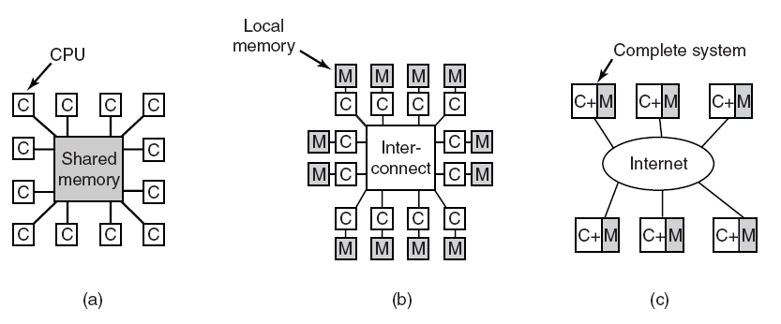
Multiple Processor System
(a) A shared-memory multiprocessor. (b) A message-passing multicomputer. (c) A wide area distributed system.

Slide 7
Architecture
Multiprocessor Systems are classified according to the manner of associating CPUs and memory units
Uniform memory access (UMA) architecture
Previously called tightly coupled multiprocessor
Also called symmetrical multiprocessor (SMP)
Examples: Balance system and VAX 8800
Nonuniform memory access (NUMA) architecture
Examples: HP AlphaServer and IBMNUMA-Q
No-remote-memory-access (NORMA) architecture
Example: Hypercube system by Intel
Is actually a distributed system

Slide 8
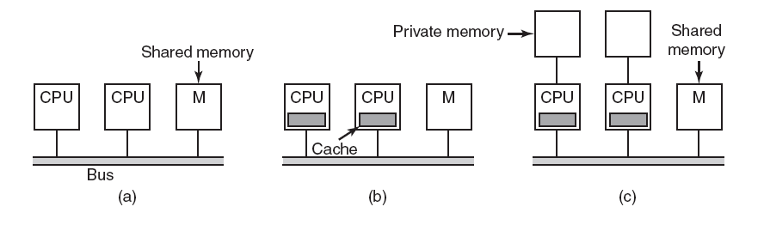
UMA Multiprocessors with Bus-Based Architectures
Three bus-based multiprocessors. (a) Without caching. (b) With caching. (c) With caching and private memories.

Slide 9
NUMA Architecture
Operating Systems, by Dhananjay Dhamdhere

Slide 10
UMA vs. NUMA
Unified Memory Access (UMA)
also known as Symmetric MultiProcessors (SMP)
Non-Unified Memory Access (NUMA)
SIMILARITIES
single memory space
pitfall: Compared between shared memory and distributed memory.
DIFFERENT
access time
# of processors
bus vs. network implementation

Slide 11
Classification of parallel system
SISD (Single Instruction Single Data)
Uniprocessors
MISD (Multiple Instruction Single Data)
Stream based processing
SIMD (Single Instruction Multiple Data = DLP)
Examples: Illiac-IV, CM-2 (Thinking Machines), Xetal (Philips), Imagine (Stanford), Vector machines, Cell architecture (Sony)
Simple programming model
Low overhead
MIMD (Multiple Instruction Multiple Data)
Examples: Sun Enterprise 5000, Cray T3D, SGI Origin, Multi-core Pentiums, and many more….

Slide 12
Classification of parallel system
SISD (Single Instruction Single Data)
Uniprocessors
MISD (Multiple Instruction Single Data)
Stream based processing
SIMD (Single Instruction Multiple Data = DLP)
Examples: Illiac-IV, CM-2 (Thinking Machines), Xetal (Philips), Imagine (Stanford), Vector machines, Cell architecture (Sony)
Simple programming model
Low overhead
MIMD (Multiple Instruction Multiple Data)
Examples: Sun Enterprise 5000, Cray T3D, SGI Origin, Multi-core Pentiums, and many more….

Slide 13
Embedded System
Characteristics of Embedded System
Prpose of Embedded System
eCOS

Slide 14
Embedded System
A combination of computer hardware and software, and designed to perform a dedicated function.
In many cases, embedded systems are part of a larger system or product, as in the case of an antilock braking system in a car

Slide 15
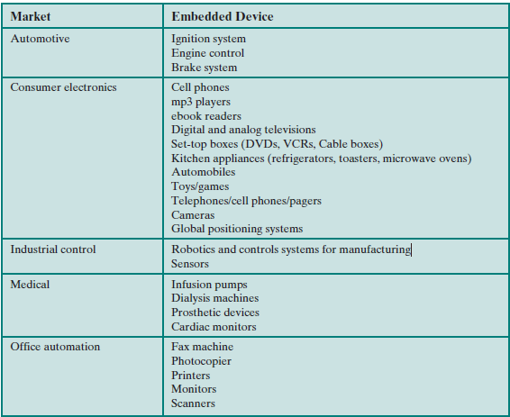
Example of Embedded System

Slide 16
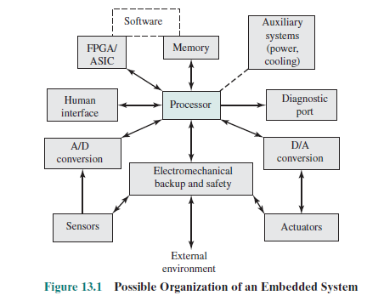
Possible Organization of Embedded System

Slide 17
Characteristics of Embedded System (1)
Real-time operation:
In many embedded systems, the correctness of a computation depends, in part, on the time at which it is delivered. Often, real-time. Constraints are dictated by external I/O and control stability requirements.
Reactive operation:
Embedded software may execute in response to external events. If these events do not occur periodically or at predictable intervals, the embedded software may need to take into account worst-case conditions and set priorities for execution of routines.

Slide 18
Characteristics of Embedded System (2)
Configurability:
Because of the large variety of embedded systems, there is a large variation in the requirements, both qualitative and quantitative, for embedded OS functionalityfor execution of routines.
I/O device flexibility:
There is virtually no device that needs to be supported by all versions of the OS, and the range of I/O devices is large.
Streamlined protection mechanisms:
Embedded systems are typically designed for a limited, well-defined functionality
Direct use of interrupts:
General-purpose operating systems typically do not permit any user process to use interrupts directly

Slide 19
Purpose Built Embedded Operating System
A significant number of operating systems have been designed from the ground up for embedded applications. Two prominent examples of this latter approach are eCos and TinyOS.

Slide 20
Specialized Embedded System
Typically include
Has a fast and lightweight process or thread switch
Scheduling policy is real time and dispatcher module is part of scheduler instead of separate component.
Has a small size
Responds to external interrupts quickly; typical requirement is response time of less than 10 μs
Minimizes intervals during which interrupts are disabled
Provides fixed or variable-sized partitions for memory management as well as the ability to lock code and data in memory
Provides special sequential files that can accumulate data at a fast rate To deal with timing constraints, the kernel provides bounded execution time for most primitives
Maintains a real-time clock

Slide 21
eCos
eCOS – Embedded Configurable Operating System
Open Source, royalty free, real time O/S for embedded application

Slide 22
Configurability
eCos configuration tool, which runs on Windows or Linux, is used to configure an eCos package to run on a target embedded system
eCos package is structured hierarchically

Slide 23
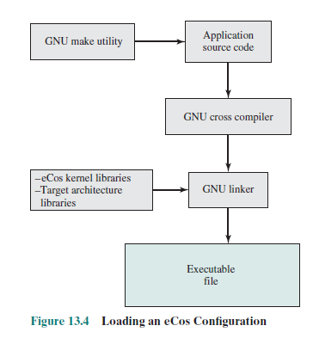
Loading eCos COnfiguration

Slide 24
eCos Component
HAL – Harwarde Abstraction Layer
HAL is software that presents a consistent API to the upper layers and maps upper-layer operations onto a specific hardware platform
eCos Kernel
Designed to meet the following objectives:
Low interrupt latency: The time it takes to respond to an interrupt and begin executing an ISR.
Low task switching latency: The time it takes from when a thread becomes available to when actual execution begins.
Small memory footprint: Memory resources for both program and data are kept to a minimum by allowing all components to configure memory as needed.
Deterministic behavior: Throughout all aspect of execution, the kernels performance must be predictable and bounded to meet real-time application requirements.

Slide 25
eCos Scheduler
Bitmap Sheduler
A bitmap scheduler supports multiple priority levels, but only one thread can exist at each priority level at any given time.
Multilevel Queue Scheduler
Supports up to 32 priority levels
allows for multiple active threads at each priority level, limited only by system resources

Slide 26
References
Stallings, W. (2014). Operating Systems: Internals and Design Principles. 8^{th.} ISBN: 978-0-13-380591-8
www.yolinux.com

